Slide 1
Welcome to Software Engineering 101
💻
🔨
🔧

Slide 2
📚 Course Name: Software Engineering 101
🖥️ Lecturer: Ace Larson (Please just call me Ace)
(Dr. Larson, Dr. Ace, Ace Sensei, Larson Sensei)
📝 Syllabus:
Participation --- 100%
Lecture: Learn from practicing (aka gaming)
Assignment: Email Ace if you want one
Textbook: None.
(Google & StackOverflow is your best friend)

Slide 3
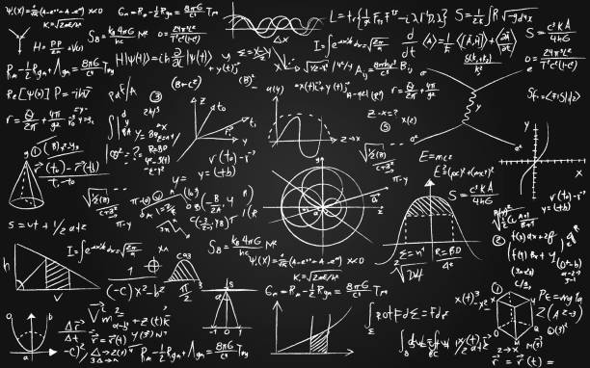
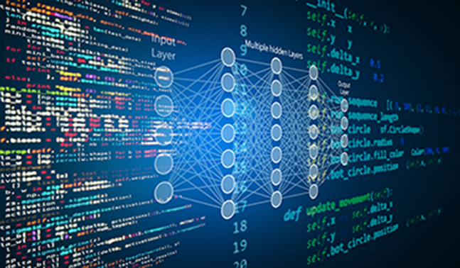
ℹ️ Useful Code
📐Useful Math & Algorithms
#include <iostream>
int main()
{
std::cout << “C++ Hello World!";
return 0;
}
Basic Algebra & Geometry
Multivariable Calc.
Linear Alg.
Matrix Derivatives
Differential Equation
All the other Math :))))))
Regression
Classification
Clustering
Artificial Neural Networks
Reinforcement Learning
Deep Learning
print(“Python Hello World")
public static void main(String[] args)
{
System.out.println(“Java Hello,
World!");
}
🔗 This is your new Bible (You’re Welcome) 🔗
https://stackoverflow.com/

Slide 4
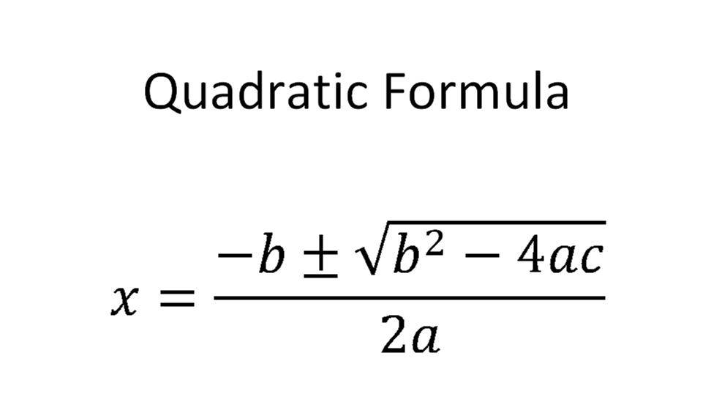

Slide 5
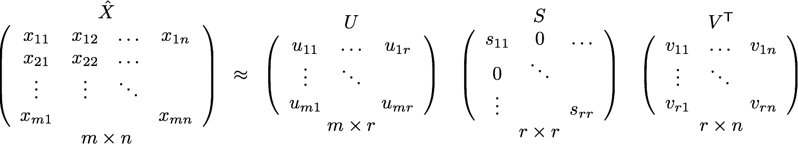

Slide 6
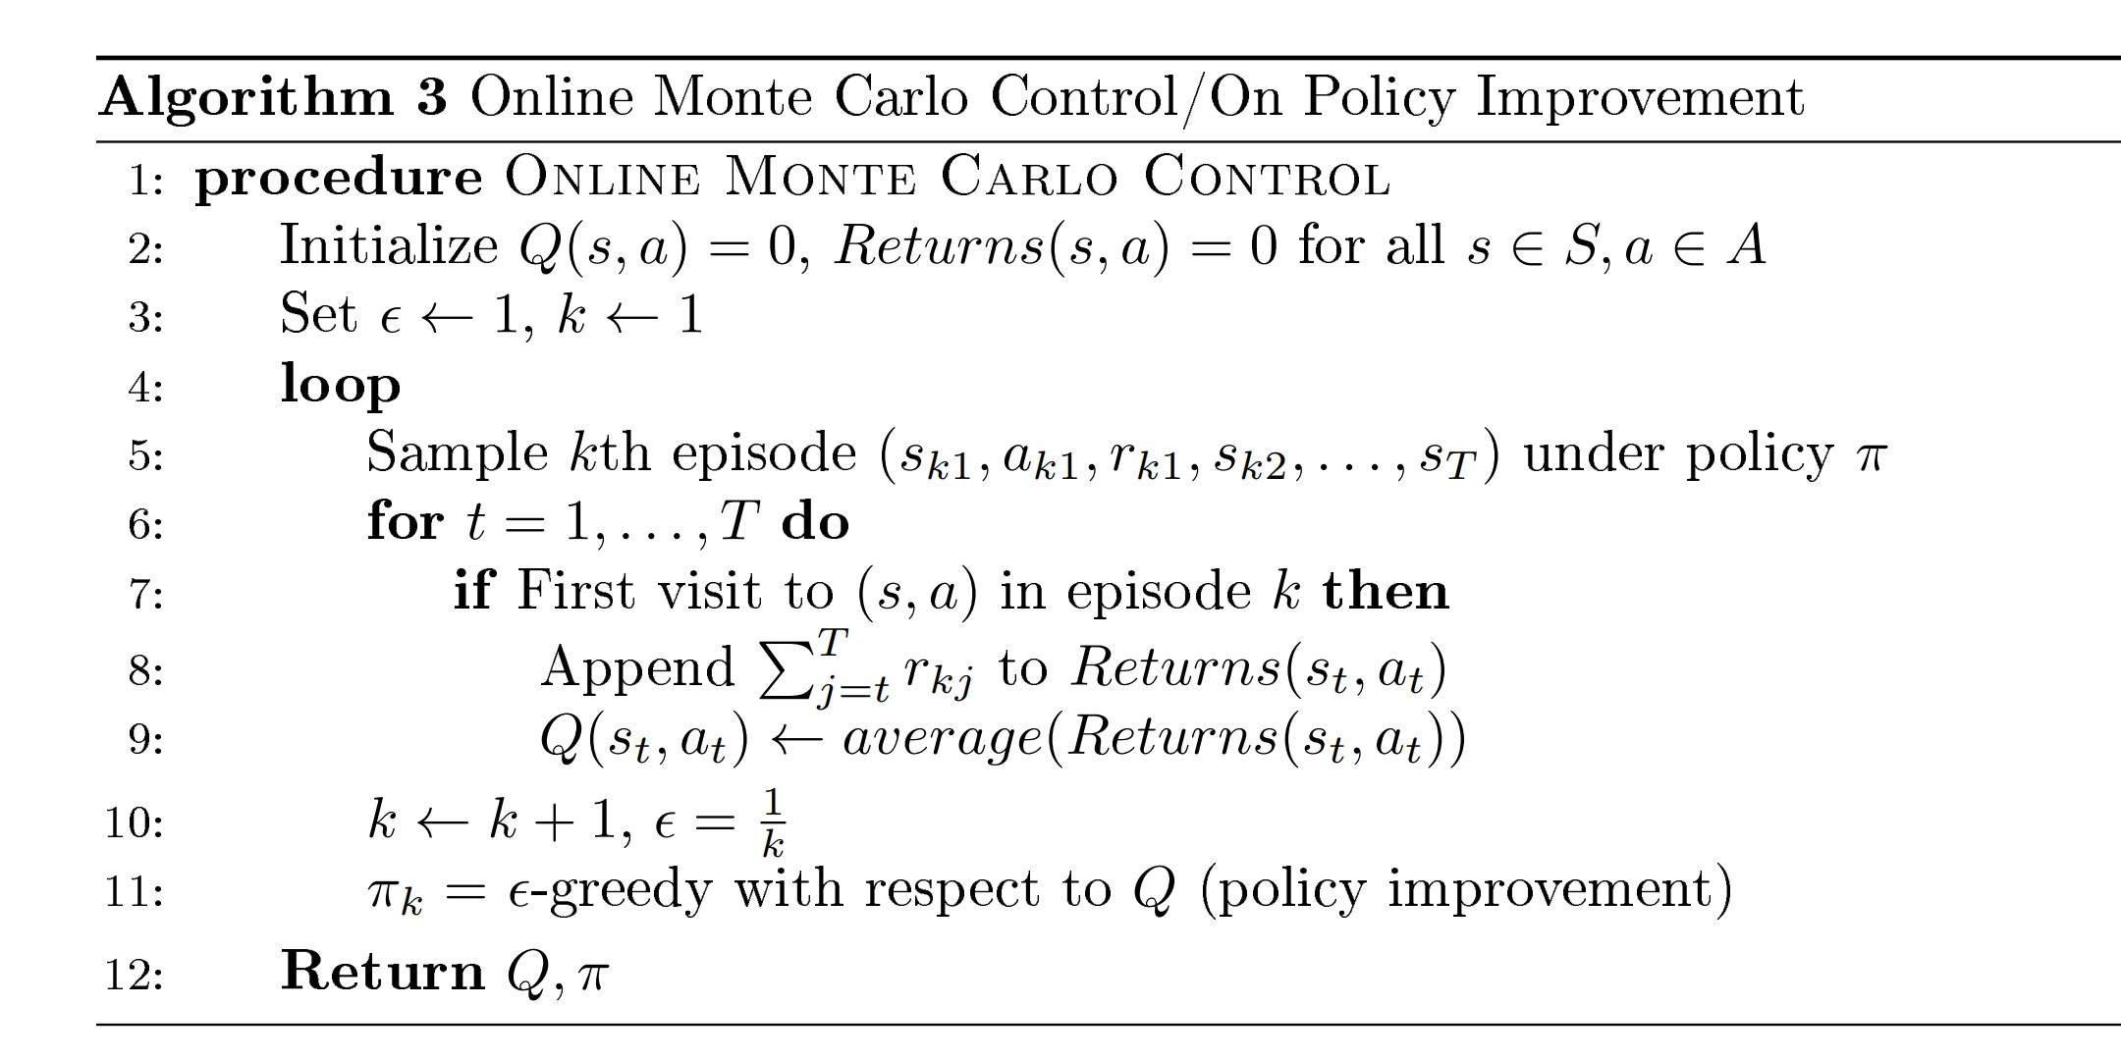

Slide 7
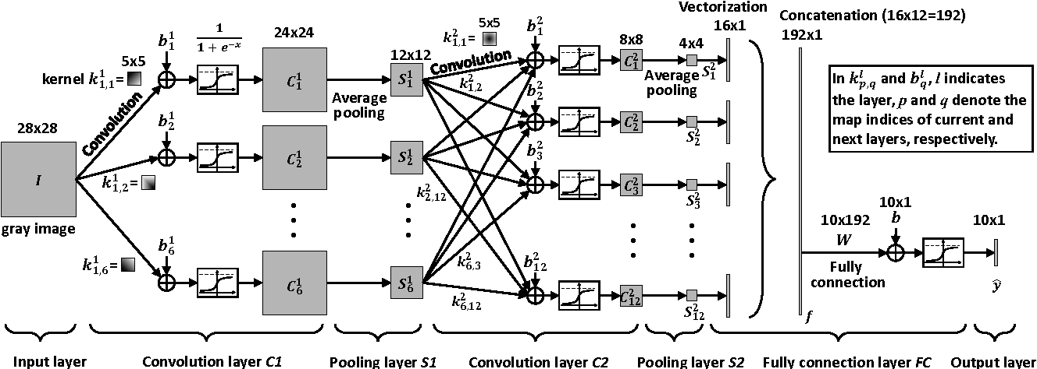

Slide 8
Practice Makes Perfect Please hack legally No more lectures

Slide 10








See You Guys tomorrow~~
This is a kind reminder that participation takes up all your grade XDD

Slide 11
Nijisanji
Application
Video

Slide 12
Software Engineering 101 – Lecture 1

